Slide 1

Machine Learning Based Human Emotion Recognition using variations in Biological Parameters
Presentation
By
L. Manish Reddy [177Y1A04D7]
Under the Guidance of
Dr. N. Srinivas
Associate Professor
Department of ECE
Department of Electronics and Communication Engineering

Slide 2

CONTENTS
MLRITM
Introduction
Objective of the work
Literature survey
Methodology
Flow Chart
SVM Classifier
Why SVM?
Result
References
Department of ECE
2

Slide 3
Introduction
MLRITM
Human life is incomplete without emotional communication.
Ten percent of the world’s population are unable to express their emotions through facial expressions.
This is due to psychological condition called ‘Alexithymia’.
Person suffering with Alexithymia cannot express his emotions or feelings even though his biological parameters like B.P, Heart Rate, Blood Viscosity, Pulse Rate are affected due to secretion of Adrenaline.
Department of ECE
3

Slide 4
Objective of the Work
MLRITM
To provide a clear picture about a person’s emotional state who is suffering with Alexithymia.
This helps to communicate a lot about the person’s internal condition as emotions are the outer make-up of a specific state of mind, and observers can easily evaluate a Person’s emotional state in order to assist him.
This helps in bringing the patient out from Alexithymia.
Department of ECE
4

Slide 5
Literature Survey
MLRITM
Andreas Haag, Silke Goronzy, Peter Schaich, and Jason Williams [2], This paper described a method of measuring emotions using bio-sensors, and recognized emotion by comparing B.P, skin conductivity, HRV(Heart rate variability).
Remarks: This was the initial approach to emotion recognition which is also quite complicated. Later facial expressions are used which is not more feasible in this case.
Department of ECE
5

Slide 6
Literature Survey
MLRITM
M. Xiaoxi, L. Weisi, H. Dongyan, D. Minghui and H. Li, "Facial emotion recognition," 2017 IEEE 2nd International Conference on Signal and Image Processing (ICSIP), Singapore, 2017, pp. 77-81.
Remarks: This report has implemented SVM machine learning classifier using facial expressions which is not much helpful in alexithymic patient.
Department of ECE
6

Slide 7
Methodology
MLRITM
Considering biological parameters: B.P, Heart Rate, Blood Viscosity, Pulse Rate and training a system to recognize the emotion.
Applying SVM classifiers to train the Machine Learning model to get maximum accuracy.
Deploying it and creating UI, which takes values and determines the emotion.
Department of ECE
7

Slide 8
Flow Chart
MLRITM
Stored Data Set
Display
Training and testing using GNB Classifier
Parameter values to be entered by user
Trained GNB Classifier
Emotion output
Decoding the output of the Trained model
Department of ECE
8

Slide 9
Naïve Bayes Classifier
MLRITM
This is a conditional probability based algorithm. It is the most widely used and fastest algorithm since it uses less training data and strong independence assumptions.
In this case, a built in function called MultinomialNaïveBayes is used.
It has 2 main functions. The first function is used to train the multinomial Naïve Bayes model based on the feature extraction and count vector.
The next step is to assign score each term.
Department of ECE
9

Slide 10
Why GNB?
MLRITM
We need to classify the input data in to 5 different target variables namely Angry, Depressed, Happy, Sad, Stressed.
After comparing with other classification algorithms GNB gave maximum accuracy of 95.20%.
Where other models accuracies are
KNN (k-nearest neighbours) classifier: 87.78%.
Decision Tree Classifier: 81.87%.
Department of ECE
10

Slide 11
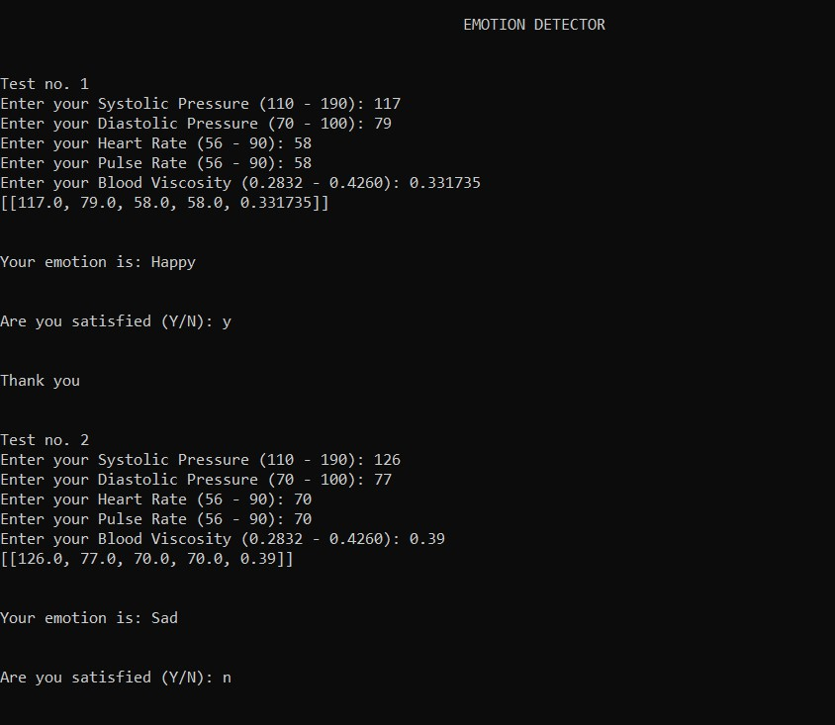
Result
MLRITM
Department of ECE
11

Slide 12
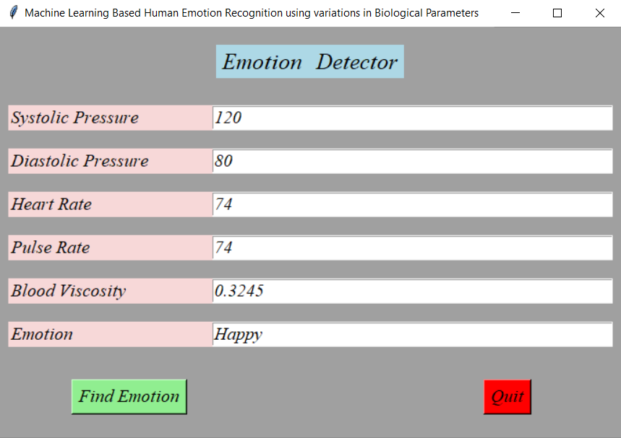
Result
MLRITM
Department of ECE
12

Slide 13
References
MLRITM
M. Xiaoxi, L. Weisi, H. Dongyan, D. Minghui and H. Li, "Facial emotion recognition," 2017 IEEE 2nd International Conference on Signal and Image Processing (ICSIP), Singapore, 2017, pp. 77-81.
Haag A., Goronzy S., Schaich P., Williams J. (2004) Emotion Recognition Using Bio-sensors: First Steps towards an Automatic System. In: André E., Dybkjær L., Minker W., Heisterkamp P. (eds) Affective Dialogue Systems. ADS 2004. Lecture Notes in Computer Science, vol 3068. Springer, Berlin, Heidelberg.
Department of ECE
13

Slide 14
References
MLRITM
https://www.geeksforgeeks.org/multiclass-classification-using-scikit-learn/
https://scikit-learn.org/stable/supervised_learning.html#supervised-learning
Department of ECE
14

Slide 15

MLRITM
Department of ECE
15

